Slide 1

Source of Business Patient Data Analysis
IMS LRx Database
Juvisync Enhancement Slides
Prepared for Merck
Jan 28, 2013

Slide 2
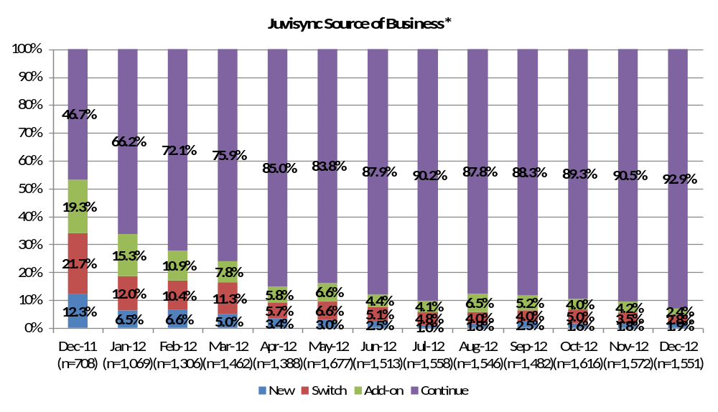
How is the Source of Business for Juvisync evolving over time?
* The Source of Business assigned to a Juvisync patient is for the Diabetes market, not the Statin market
Jan 28, 2013

Slide 3
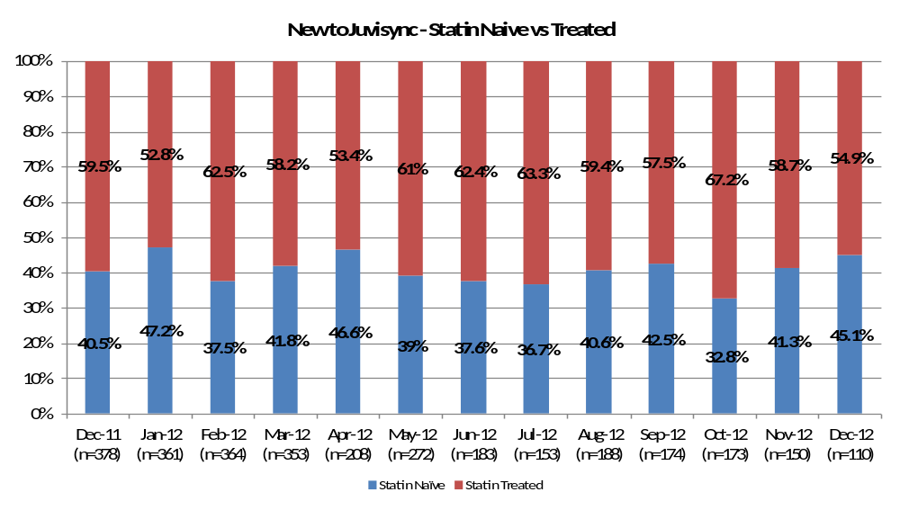
What percentage of patients who are New to Juvisync are Statin naïve?
Note: New to Juvisync = New + Switch To+ Add On
Jan 28, 2013

Slide 4
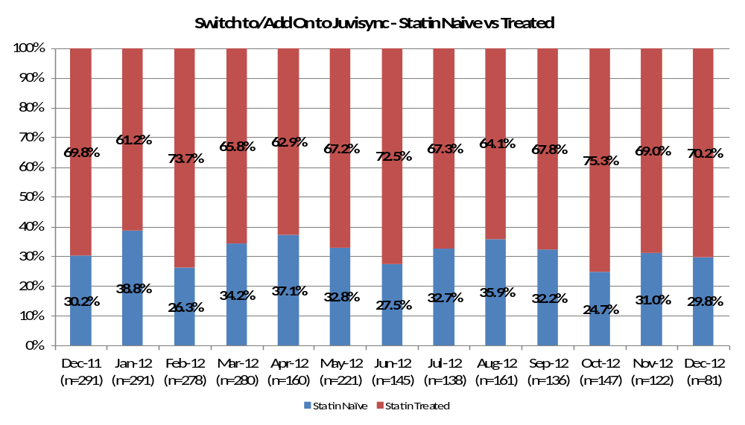
Of the Juvisync patients who have been on a diabetes product before, what percentage are Statin naïve?
Note: Includes Switch To+ Add On patients only
Jan 28, 2013

Slide 5
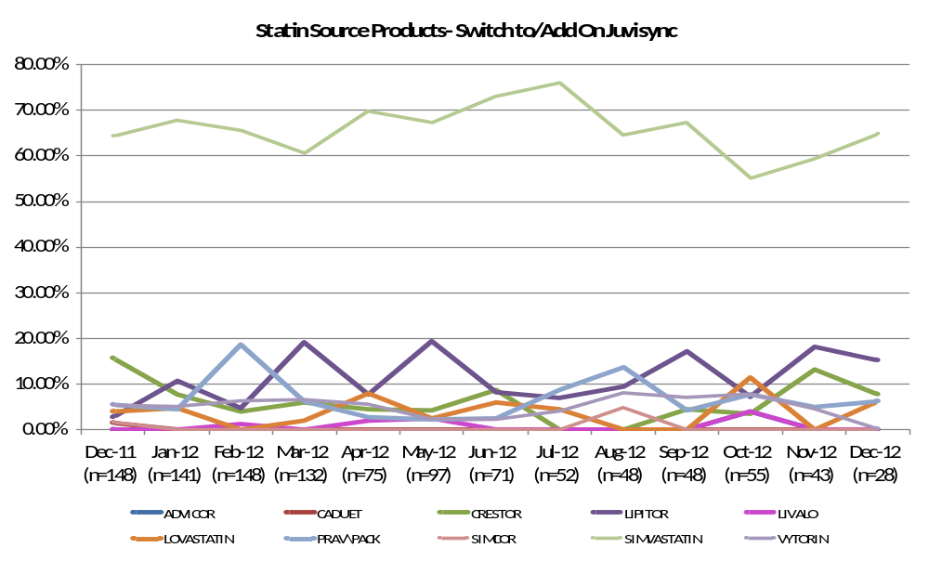
Which Statin are patients on prior to taking Juvisync?
Jan 28, 2013

Slide 6
For patients who switch to/add on Juvisync and have prior Statin therapy, which Statin product and dose combinations are the most common?
Top 10 Statin Source Products and Dose
Switch to/Add On Juvisync
Current Data Month: Dec-12 (n=28)
STATIN | STRENGTH | %
SIMVASTATIN | 20MG | 27.90%
SIMVASTATIN | 40MG | 21.40%
LIPITOR | 10MG | 15.10%
SIMVASTATIN | 80MG | 8.20%
CRESTOR | 10MG | 7.60%
SIMVASTATIN | 10MG | 7.30%
LOVASTATIN | 20MG | 6.20%
PRAV\PACK | 20MG | 6.20%
ALL OTHER |  | 0.00%
TOTAL |  | 100%
Jan 28, 2013

Slide 7
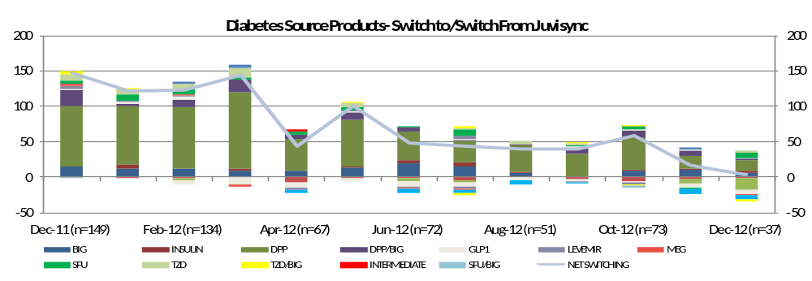
For the patients that are switching to Juvisync, from which products are they coming? For the patients switching away from Juvisync, to which products are they going?
 | Dec-11 (n=149) | Jan-12 (n=126) | Feb-12 (n=134) | Mar-12 (n=158) | Apr-12 (n=67) | May-12(n=107) | Jun-12 (n=72) | Jul-12 (n=71) | Aug-12 (n=51) | Sep-12 (n=50) | Oct-12 (n=73) | Nov-12 (n=41) | Dec-12 (n=37)
BIG | 9.5% | 8.9% | 9.0% | 5.8% | 13.0% | 11.9% | 27.4% | 20.3% | 9.8% | 0.0% | 11.1% | 23.0% | 13.9%
INSULIN | 0.0% | 4.5% | 0.0% | 1.1% | 0.0% | 1.8% | 5.5% | 8.6% | 2.7% | 0.0% | 2.9% | 5.0% | 10.3%
DPP | 57.2% | 65.6% | 63.9% | 68.8% | 67.6% | 61.2% | 56.4% | 42.7% | 74.3% | 65.9% | 61.1% | 44.4% | 37.4%
DPP/BIG | 15.4% | 3.3% | 8.6% | 11.6% | 8.3% | 9.7% | 7.7% | 2.1% | 4.4% | 16.1% | 13.7% | 18.4% | 6.0%
GLP1 | 1.5% | 1.8% | 2.7% | 0.0% | 0.0% | 2.1% | 0.0% | 2.6% | 0.0% | 4.1% | 2.7% | 4.2% | 0.0%
LEVEMIR | 2.8% | 1.7% | 1.3% | 0.0% | 0.0% | 1.7% | 0.0% | 5.4% | 0.0% | 0.0% | 0.0% | 0.0% | 5.8%
MEG | 1.3% | 0.0% | 1.3% | 0.0% | 0.0% | 0.0% | 0.0% | 0.0% | 0.0% | 0.0% | 0.0% | 0.0% | 0.0%
SFU | 3.0% | 7.2% | 5.6% | 1.4% | 7.9% | 3.7% | 2.9% | 12.2% | 0.0% | 4.1% | 5.5% | 0.0% | 16.3%
TZD | 6.9% | 5.2% | 5.9% | 8.7% | 0.0% | 6.2% | 0.0% | 3.3% | 8.8% | 4.1% | 0.0% | 0.0% | 10.3%
TZD/BIG | 2.3% | 1.8% | 0.0% | 0.0% | 0.0% | 1.7% | 0.0% | 2.8% | 0.0% | 5.7% | 2.9% | 0.0% | 0.0%
SFU/BIG | 0.0% | 0.0% | 1.7% | 2.5% | 0.0% | 0.0% | 0.0% | 0.0% | 0.0% | 0.0% | 0.0% | 4.9% | 0.0%
INTERMEDIATE | 0.0% | 0.0% | 0.0% | 0.0% | 3.2% | 0.0% | 0.0% | 0.0% | 0.0% | 0.0% | 0.0% | 0.0% | 0.0%
Jan 28, 2013

Slide 8
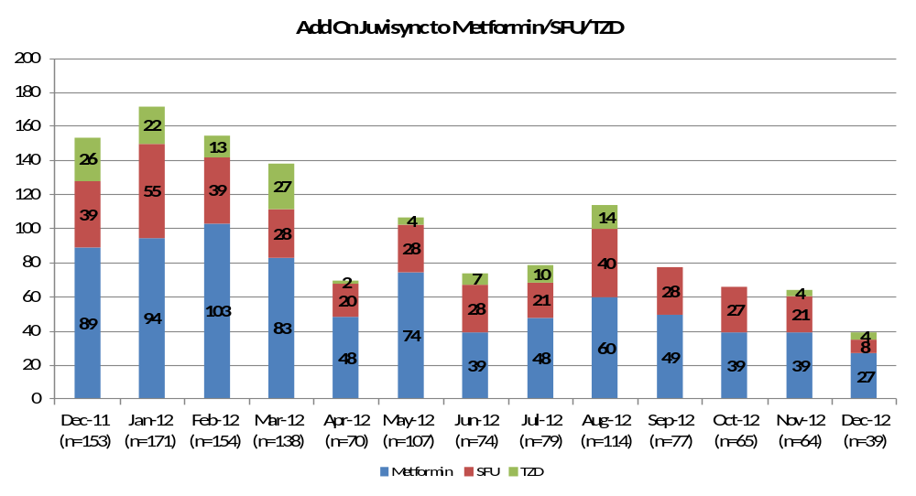
Is Juvisync being added on to Metformin, SFU, or TZD most often?
Jan 28, 2013

Slide 9
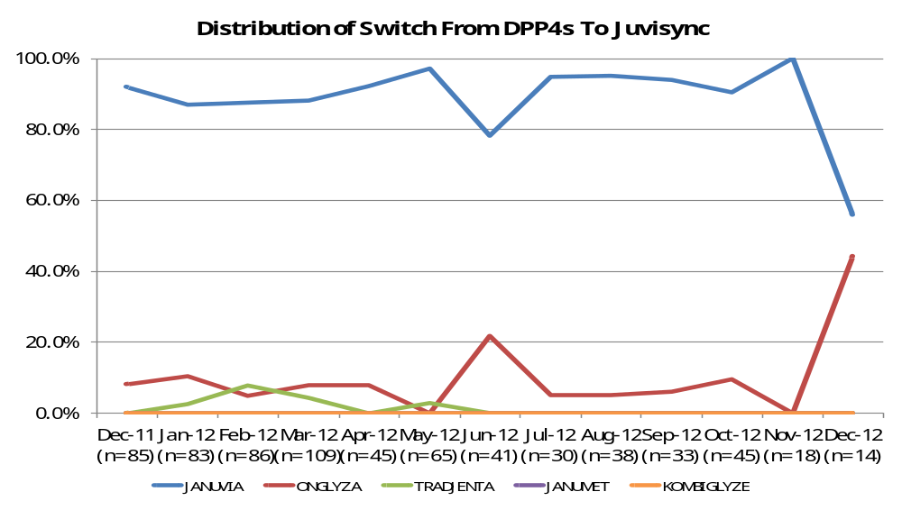
Does Juvisync pull from other DPP4 competitors? Or does it pull only from Merck brands?
Jan 28, 2013

Slide 10
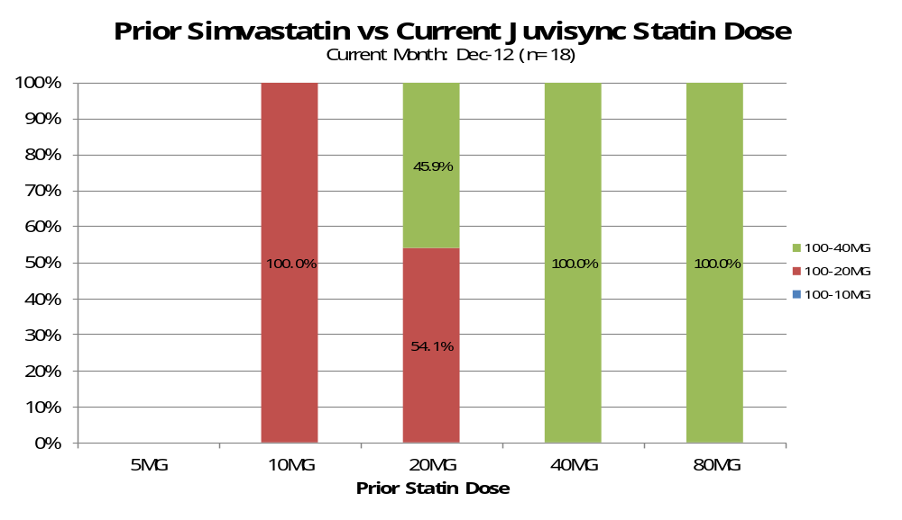
Are physicians titrating the Simvastatin dose when switching to Juvisync? Or are patients staying at the same dose?
Jan 28, 2013

Slide 11
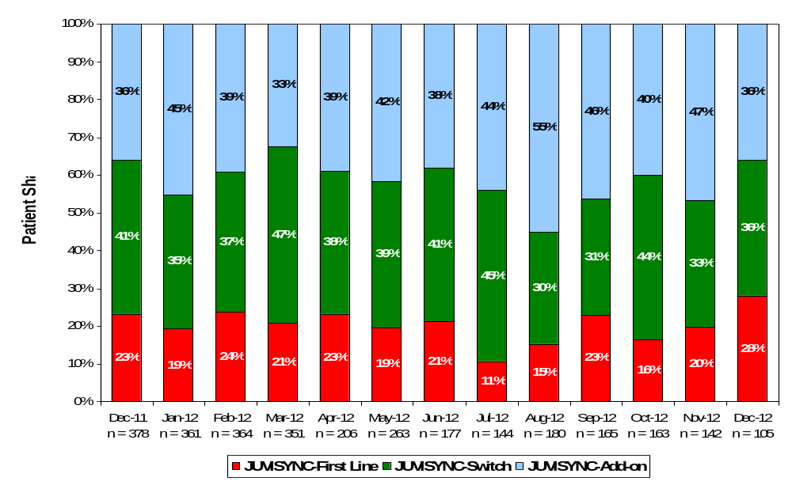
Percentage of first line and non-first line utilization of JUVISYNC

Slide 12
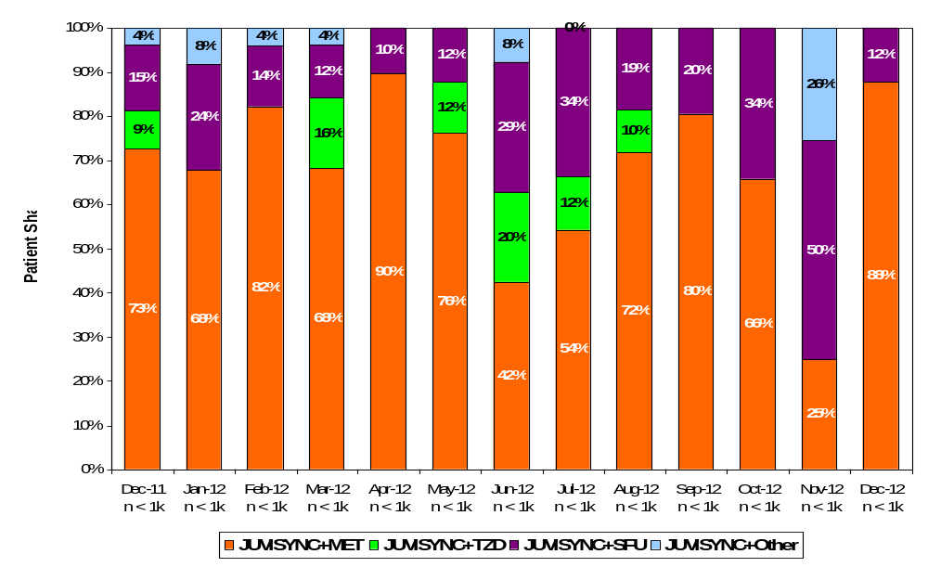
Use of JUVISYNC in combination with 1 OAD

Slide 13
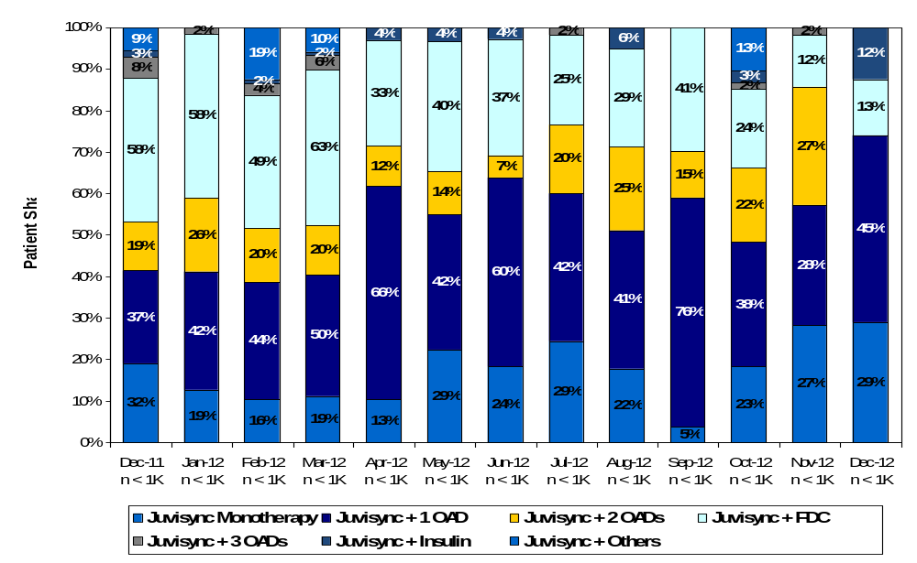
JUVISYNC Second Line w # of Agents - All PCPs

